Slide 1
THE ERA OF USING BIG DATA, ARTIFICIAL INTELLIGENCE AND MACHINE LEARNING IN CENTRAL BANKS AND FINANCIAL INSTITUTIONS: IMPLICATIONS FOR MONETARY POLICY Victor Murinde, Executive Director, AERC Dennis Mwarange, Office of the Executive Director, AERC Hannah Ngugi, Office of the Executive Director, AERC Charles Sewe, Office of the Executive Director, AERC
GUEST SPEAKER PRESENTATION
SYMPOSIUM FOR COMESA CENTRAL BANK GOVERNORS, ESWATINI, 7th NOVEMBER 2024

Slide 2
Background: Take a Trip down Memory Lane
Irving Fisher’s Quantity Theory of Money, MV=PT, in 1911
The IS-LM model, developed by John Hicks in 1937, based on Keynesian theories
The flow of funds, Morris Copeland in 1952, and asset demand equations
The rational expectations revolution, by Lucas and Sargent in the 1970s
The Econometric Society, founded in December 1930, by Irving Fisher and others - with data-driven methods for monetary policy
And now, all change: Big data, AI, and ML
Hence, we focus on the era of using Big Data, AI, and ML to better understand:
how advances in BD, AI, and ML are impacting Central Banks and financial institutions;
the implications of these developments on monetary policy
to create knowledge, of great benefit to central banks in the COMESA region

Slide 3
Road Map of this Presentation
What do we really know about Big Data, Artificial Intelligence (AI), and Machine Learning (ML)?
The use of Big Data, AI, and ML in Financial Institutions: Applications, opportunities, as well as challenges and risks
The use of Big Data, AI, and ML in Central Banks: OECD and Africa
The key applications for monetary policy, some priorities, challenges, and mitigation of risk
Concluding remarks, key ‘takeaways’, and the role of the AERC
Additional information and references to ignite research in this area

Slide 4
What is Big Data?
Big Data refers to extremely large and complex datasets that are too big to be processed using traditional data processing tools
These datasets can come from various sources, including social media, sensors, transactions, the Internet of Things (IoT), etc…
Data can be structured (like financial transactions) or unstructured (like social media posts)
The ‘Big Five’ of ‘Big Data’: The five defining dimensions or properties of Big Data

Slide 5
The ‘Big Five’ of ‘Big Data’
Big data: datasets that are too large or complex to be dealt with by traditional data processing application software
Big data has 5 distinct characteristics:
Volume – scale of data; i.e., the volume of data being generated
Veracity – the uncertainty of data, i.e., the discrepancies inherent in the data
Value – it is critical not only to have access to data but also to have data that is usable
Velocity – the speed at which data is emanating and changing between different datasets
Variety –different forms of data
Source: https://medium.com/@varunmishrait76/what-is-big-data-78a934cf4e4b

Slide 6
What is Artificial Intelligence (AI)?
International Finance Corporation (IFC) defines Artificial intelligence (AI) as “the science of making machines act in rational, intelligent ways”
These smart machines simulate human intelligence processes to perform tasks that require human intelligence - tasks such as reasoning, learning, problem-solving, understanding natural language, perception, and decision-making
Existing literature distinguishes between two types of AI:
Narrow AI: AI systems that are designed to perform a specific task, such as image recognition or language translation
General AI: a theoretical AI that would be capable of performing any intellectual task that a human can do

Slide 7
What is AI? Cont’d…
Examples of AI are Face ID, the search algorithm, the recommendation algorithm, algorithmic trading in financial markets
Examples of generative AI are Copilot, Google’s Bard, ChatGPT, or DALL-E from OpenAI
Their applications include but are not limited to, healthcare and pharmaceutical services, manufacturing, and financial services

Slide 8
Use of AI in the World by Industries and Departments in 2023

Slide 9
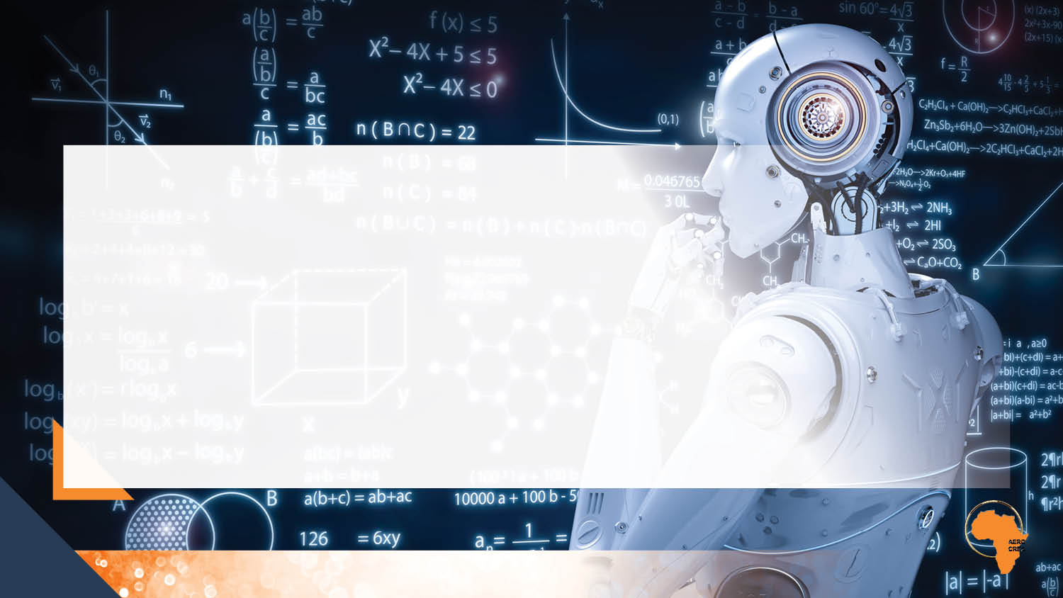
What is Machine learning (ML)?
The process of using mathematical models of data to help a computer learn without direct instruction
It is considered a subset of artificial intelligence (AI)
ML learning uses algorithms to identify patterns within data, and those patterns are then used to create a data model that can make a prediction
With increased data and experience, the results of ML are more accurate

Slide 10
Some key ML techniques
Supervised learning: Addressing datasets with labels or structure, data acts as a teacher and “trains” the machine, increasing in its ability to make a prediction or decision.
Unsupervised learning: Addressing datasets without any labels or structure, finding patterns and relationships by grouping data into clusters.
Reinforcement learning: A computer program helps determine outcome based upon a feedback loop.

Slide 11
Cont’d…
Deep learning / neural networks:
Deep learning is an advanced type of ML that uses networks of algorithms that are inspired by the structure of the brain - neural networks. Deep learning typically requires a large data set to train on; training sets for deep learning are sometimes made up of millions of data points
Transformer model:
A transformer is a deep learning model that adopts the mechanism of self-attention, differentially weighing the significance of each part of the input data or tracking relationships in data, like word order in a sentence, but can be applied to other scenarios including fraud detection

Slide 12
Use of Big Data, AI, and ML in Financial Institutions
Application/Opportunities
Asset management
The use of AI and ML in asset management has the potential to increase the efficiency and accuracy of operational workflows, enhance performance, strengthen risk management, and improve the customer experience
Algorithmic Trading
AI can be used in trading both to provide trading strategy suggestions and to power automated trading systems that make predictions, choose the course of action and execute trades
AI-based trading systems operating in the market can identify and execute trades entirely on their own, without any human intervention
Also assists traders in risk management
Sources: Shabsigh, G. (2023); Javaid (2024); Begenau et al.(2018); Lopez-Corleone et al.(2022)

Slide 13
Cont’d…
Credit intermediation and assessment of creditworthiness
AI-based models and big data are increasingly being used by banks and fintech lenders to assess the creditworthiness of prospective borrowers and make underwriting decisions, both functions at the core of finance
In the context of credit scoring, ML models are used to predict borrowers’ defaults with superior forecasting accuracy compared to standard statistical models
Integration of AI in Blockchain-based financial products
AI algorithms can execute blockchain-based trades at high speeds and with precision, based on real-time data analysis and predictive models, improving trading efficiency and performance
AI also analyzes blockchain data to offer insights and recommendations for optimizing investment portfolios, including those involving cryptocurrencies and blockchain assets
Sources: Shabsigh (2023); Javaid (2024); Begenau, et al. (2018); Lopez-Corleone et al. (2022)

Slide 14
Cont’d…
Challenges and Potential Risks
Risk of tacit collusions
AI and ML can cause similar trading behaviors among different entities due to the use of similar algorithms and data-driven strategies
This can result in coordinated price movements and market impact without explicit agreements
Employment risks and the question of skills
The deployment of AI and big data in finance requires different skills which only a few of the workers and leaders in finance have
Firms will need to invest in human capital and acquire skills related to AI and Big Data management if they have to exploit value from data
AI and ML technologies are likely to render some workers jobless as machines replace humans in automated processes
Sources: Shabsigh (2023); Javaid (2024); Begenau et al. (2018); Lopez-Corleone et al.(2022)

Slide 15
Use of Big Data, AI and ML in Central Banks
Monetary Policy and Economic Forecasting:
Big data and AI enable central banks to analyse vast amounts of financial and economic data for more accurate forecasting and decision-making in monetary policy.
Regulatory Compliance and Supervision:
AI and machine learning help in monitoring financial institutions for compliance with regulations, detecting potential risks, and improving oversight efficiency.
Source: Araujo et al.(2024);Doerr et al. (2021)

Slide 16
Cont’d…
Globally
The Bank of Canada: Since 2017, the bank has used AI to forecast inflation, economic activity, and demand for bank notes, track sentiments in key sectors of the economy, clean and verify regulatory data, improve efficiency and de-risk operations
The European Central Bank (ECB): The ECB has used AI and Big data in communication, macroeconomic trends analysis, monitoring financial stability, assessing the effectiveness of monetary policy, and detecting systemic risks
Federal Reserve (U.S.): Since 2011, the Federal Reserve has done away with the traditional supervision and forecasting methods. With modern technologies, the Federal Reserve uses ML models for economic forecasting, fraud detection, and monitoring of financial institutions. It also uses AI and Big data to analyze large datasets for better decision-making
Bank of England: Since 2014, the Bank of England has been exploring the use of AI and ML in areas such as economic modeling, regulatory compliance, and financial stability monitoring
Source: Bank of England (2023), Bank of Canada- Macklem (2024), BIS Report (2024)

Slide 17
Cont’d…
Africa
The South African Reserve Bank: SARB uses Big Data and ML for fraud detection, financial stability monitoring, and enhancing its regulatory oversight. In 2022, the SARB published a working paper titled "Big Data Forecasting of South African Inflation,“ which shows the effort to incorporate these tools in forecasting, analysis and policy formulation(South African Reserve Bank)
The Central Bank of Kenya (CBK) utilizes data from mobile money platforms to monitor economic activity and financial inclusion. Since the early 2020s, Kenya has also been exploring the potential of AI and ML in financial regulation and supervision to enhance financial services, reduce risk, and increase operational efficiency
The Central Bank of Nigeria (CBN): Since the early 2020s has been incorporating AI, Big Data, and ML to enhance credit risk assessment, improve financial stability monitoring, and combat fraud and money laundering
Concerning monetary policy, AI adoption is still in its early stages in many African central banks. There is growing interest in using AI to improve the accuracy and timeliness of policy analysis
Sources:
Bank of England: https://www.bankofengland.co.uk/prudential-regulation/publication/2022/october/artificial-intelligence
Bank of Canada: Artificial intelligence, the economy and central banking - Bank of Canada
Bank of International Settlements: BIS Annual Economic Report 2024
SARB: Big data forecasting of South African inflation
Central Bank of Kenya:1598390763_Banking Sector Innovation Survey 2022.pdf

Slide 18
Selected Central Banks Using Big Data, AI and ML(Araujo, Doerr, Gambacorta and Tissot, 2024)
Name of Central Bank | Application Type
Bank Indonesia | Macro/financial analysis for monetary policy
Bank of France | Macro/financial analysis for monetary policy, and Supervision
Reserve Bank of Australia | Macro/financial analysis for monetary policy
Reserve Bank of New Zealand | Macro/financial analysis for monetary policy
Bank of Canada | Macro/financial analysis for monetary policy, and Payments oversight
Bank of Korea | Macro/financial analysis for monetary policy, and Payments oversight
Federal Reserve | Macro/financial analysis for monetary policy, and Supervision
Central Bank of India | Macro/financial analysis for monetary policy, and Payments oversight
Central Bank of Malaysia | Macro/financial analysis for monetary policy, and Supervision
Central Bank of Chile | Macro/financial analysis for monetary policy
Bank of England | Macro/financial analysis for monetary policy
Bank of Italy | Macro/financial analysis for monetary policy, Supervision, and Payments oversight
Czech National Bank | Macro/financial analysis for monetary policy
Bank of Thailand | Payments oversight
Central Bank of Ecuador | Payments oversight
Central Bank of Iceland | Payments oversight
Bank of Japan | Supervision
Bank of Spain | Supervision
Banco de Portugal | Supervision
Central Bank of Brazil | Supervision
Bank of the Republic of Austria | Supervision
Monetary Authority of Singapore | Supervision
South African Reserve Bank | Macro/financial analysis for monetary policy

Slide 19
Use of Big Data, AI and ML for Monetary Policy
Inflation Targeting:
CBs can comprehensively analyze price movements and economic indicators, improving the ability to track and target inflation
AI and ML tools can predict inflation trends by analyzing vast datasets and identifying patterns that may not be otherwise detected by traditional methods, helping central banks set more accurate inflation targets
Interest Rates Setting:
AI allows central banks to analyze economic data, including real-time financial transactions and market trends as well as model complex economic scenarios and predict the effects of interest rate changes on the economy
Communication of Monetary Policy:
Big data and AI ensure policy decisions are well understood by the public, and inflation expectations are kept well-anchored
Sources: Doerr, et al. (2021); Chiranjit and Joseph (2017); Cipollone (2024); Ozili (2024)

Slide 20
Cont’d…
Exchange Rates Movements:
Big Data, AI, and ML help central banks monitor global economic conditions, as well as predict and analyze exchange rate fluctuations by processing large datasets from different sources; thus, helping informed decisions about currency interventions and policy adjustments
Money Supply:
Big Data, AI, and ML allow CBs to analyze spending patterns and money flows and predict demand and anomalies in financial behavior which can help central banks monitor and adjust money supply
Monetary Policy Transmission:
AI tools allow for real-time monitoring of economic indicators such as inflation rates, employment figures, and consumer spending as well as simulation of the monetary policy transmission mechanisms; hence, central banks can assess the immediate impact of monetary policy decisions and adjust the needed strategies
Sources: Doerr et al. (2021); Chiranjit and Joseph(2017); Cipollone (2024); Ozili (2024)

Slide 21
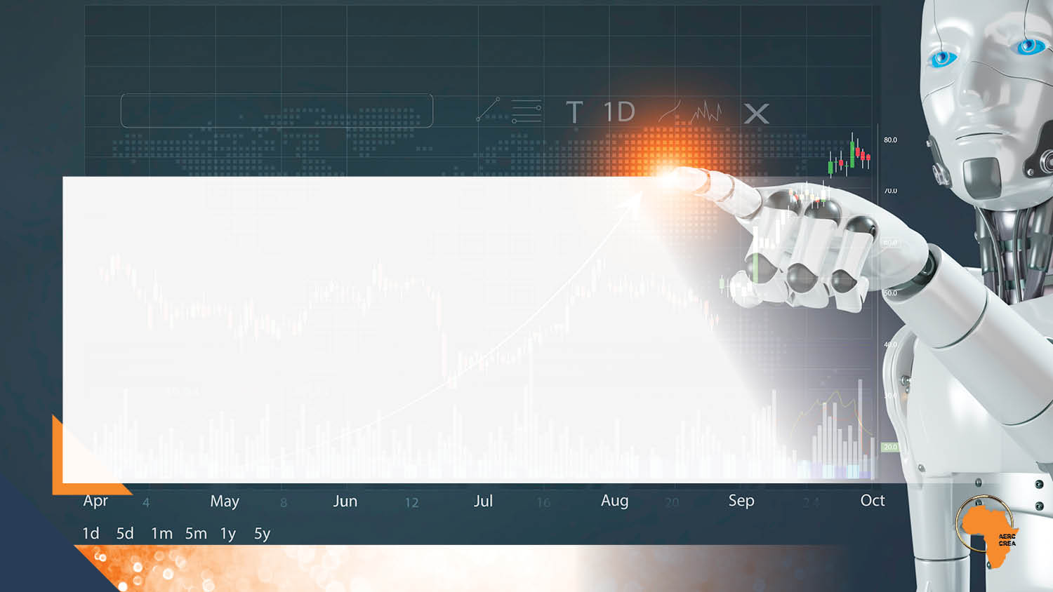
Forecasting Precision of ML methods (Yossi Shvimer, Victor Murinde and Avi Herbon, 2021)
Table 2: Out of sample results in 5 different models
Hybrid LSTM-ARIMA with sentiment 3.00681 1.7069
Hybrid LSTM-ARIMA without sentiment 3.01327 1.72781
ARIMA 3.18904 1.73033
LSTM with sentiment 10.8492 5.44829
LSTM without sentiment 10.997 5.71967
Table 2 shows that Hybrid LSTM-ARIMA with sentiment has the lowest RMSE score and MAE score

Slide 22
What are the Priorities?
1
2
3
Scenario Analysis:
AI models allow central banks to simulate various economic scenarios and assess the potential impacts of different policy decisions, helping policymakers to evaluate the effectiveness of their interventions under different conditions and choose the most appropriate course of action
Effective Communication Strategies:
AI can assist central banks in crafting clear and effective communication strategies by analysing how different messages are received by the public and financial markets, to enhance the credibility and transparency of monetary policy, leading to more stable market expectations
Stakeholder Engagement:
Big data enables central banks to engage more effectively with stakeholders, including the public, financial institutions, and government bodies; by understanding the concerns and expectations of these groups through data analysis, central banks can better align their policies with the needs of the economy.

Slide 23
Challenges and Limitations
Handling Big data is Resource Intensive: Collecting and accessing information, infrastructure, high data security measure and high staff costs to clean data
Lack of Transparency:
Some AI and ML algorithms, especially deep learning models, are complex and operate like ‘black boxes’. People need to know how these models arrive at specific decisions
Privacy and Security Issues:
As data collection grows, protecting personal financial information and ensuring its security become essential
Potential Biases:
AI systems may reinforce existing biases in data, potentially resulting in unjust decisions or prejudiced outcomes

Slide 24
Cont’d…
Underlying Quality of Data may be low for public authorities like Central Banks:
Data might not be well structured, or measurements might introduce biases
Regulatory and Ethical Questions:
The fast-paced development of these technologies challenges current regulations and raises ethical concerns about their application
Reduce Operational resilience:
Over-reliance on AI to perform core tasks can weaken an organization's ability to withstand and recover from disruptions if AI systems fail or cause errors
Unethical Use: AI models can be used to spread false information and data, facilitate fraud or launch cyberattacks
Central banks Risk Falling into “Echo-chamber’ trap:
AI may become self-referential, repeating existing biases and increase the risk of forward guidance

Slide 25
Recommendations to Overcome Existing Challenges’…
Eliminate bias in AI models: Use diverse and representative data, conduct biased audits for biased outcomes, and involve diverse teams in the design and implementation of AI systems to enhance inclusivity
Criteria and process of algorithms should be clear (improve interpretability of machine learning models) and be audited to enhance transparency to the public
State-of-the-art security is required to ensure data safety and eliminate cyberattacks
Reduce overdependence on AI as they are prone to errors and system failures
Enhanced collaboration between regulatory bodies and AI developers as a crucial strategy for improving the resilience and transparency of financial systems
Invest in AI Literacy and Training: Building expertise in AI and machine learning within central banks is essential to effectively implement and oversee AI technologies

Slide 26
Concluding Remarks
The integration of Big Data, AI, and Machine Learning into monetary policy represents a transformative shift in how central banks and financial institutions operate; the technologies enable more accurate, real-time insights into responsive policy decisions
By leveraging vast datasets and advanced algorithms, policymakers can better anticipate market trends, manage risks, and ensure financial stability
However, the rapid pace of technological change also presents challenges, including the need for robust data governance, and the continuous upskilling of personnel
The successful application of these technologies will be pivotal in shaping the future of monetary policy, driving innovation, and enhancing the effectiveness of monetary policy in an increasingly complex global landscape
Nevertheless, humans need to stay in control of AI systems not only to guarantee their ethical use but also to handle accountability and sustain public confidence in these technologies; AI should complement (and not replace) human thinking

Slide 27
The AERC aims to prioritize Big Data, AI, and ML in its Strategic Plan 2025-2035, as an integral component of capacity building and knowledge generation in Africa

Slide 28
References
Acemoglu, D. (2024). The Simple Macroeconomics of AI (No. w32487). National Bureau of Economic Research.
Adapaneni, N. R. (2019). Artificial intelligence in finance and investments. International Journal of Innovative Research in Science, Engineering and Technology 9 (5).
Agarwal, B., Agarwal, H., & Talib, P. (2019). Application of artificial intelligence for successful strategy implementation in India's banking sector. International Journal of Advanced Research, 7(11), 157–166
Ahmed, S., Alshater, M. M., El Ammari, A., & Hammami, H. (2022). Artificial intelligence and machine learning in finance: A bibliometric review. Research in International Business and Finance, 61, 101646.
Aldasoro, I., Doerr, S., Gambacorta, L., Notra, S., Oliviero, T., & Whyte, D. (2024). Generative artificial intelligence and cyber security in central banking. Journal of Financial Regulation, fjae008.
Araujo, D., Bruno, G., Marcucci, J., Schmidt, R., & Tissot, B. (2023). Machine learning applications in central banking. Journal of AI, Robotics & Workplace Automation, 2(3), 271-293.
Athey, S and G Imbens (2021): “Machine learning methods that economists should know about”, Annual Review of Economics, no 11, pp 685–725.
Bank of England (2024a). Artificial Intelligence and Machine Learning. Discussion Paper 5/22
Bank of England (2024b), Forecasting for monetary policy-making and communication at the Bank of England: a review
Begenau, J., Farboodi, M., & Veldkamp, L. (2018). Big data in finance and the growth of large firms. Journal of Monetary Economics, 97, 71-87.
Bodislav, D. A., Florina, B. R. A. N., Petrescu, I. E., & Gomboș, C. C. (2024). The Integration of Machine Learning in Central Banks: Implications and Innovations. European Journal of Sustainable Development, 13(4), 23-23.

Slide 29
C`ont’d…
Chakraborty, C., and Joseph, A., (2017): “Machine learning at central banks”, Bank of England Working Paper, no 674.
Cipollone, P. (2024, July). Artificial intelligence: a central bank’s view. In Keynote speech at the National Conference of Statistics on official statistics at the time of artificial intelligence. Rome (Vol. 4).
Danielsson, J., Macrae, R., & Uthemann, A. (2022). Artificial intelligence and systemic risk. Journal of Banking & Finance, 140, 106290.
de Araujo, D. K. G., Doerr, S., Gambacorta, L., & Tissot, B. (2024). Artificial intelligence in central banking (No. 84). Bank for International Settlements.
Doerr, S. (2024) .AI in central banking: use cases, opportunities and challenges. Bank for International Settlements.
Doerr, S., Gambacorta, L., and Maria S, J. (2021). Big data and machine learning in central banking. BIS Working Papers, No 930.
Herrmann, H., & Masawi, B. (2022). Three and a half decades of artificial intelligence in banking, financial services, and insurance: A systematic evolutionary review. Strategic Change, 31(6), 549-569.
Ibrahim, U. A., & Nwobilor, C. J. (2020). Artificial intelligence as a tool for decision making: A perspective from the central bank of Nigeria. International Journal of Managerial Studies and Research, 8(1), 76-85.
Kahyaoglu, H. (2021). The Impact of Artificial Intelligence on Central Banking and Monetary Policies. The Impact of Artificial Intelligence on Governance, Economics and Finance, Volume I, 83-98.
Javaid, H. A. (2024). The Future of Financial Services: Integrating AI for Smarter, More Efficient Operations. MZ Journal of Artificial Intelligence, 1(2).

Slide 30
C`ont’d…
Lopez-Corleone, M., Begum, S., & Sixuan Li, G. (2022). Artificial intelligence (AI) from a regulator’s perspective: The future of AI in Central Banking and financial services. Journal of AI, Robotics & Workplace Automation, 2(1), 7-16.
Njoroge, L. (2024). Role of Artificial Intelligence (AI) in Central Banking: Implications for COMESA Member Central Banks. COMESA Working Paper
OECD (2023), OECD Employment Outlook 2023: Artificial Intelligence and the Labour Market, OECD Publishing, Paris, https://doi.org/10.1787/08785bba-en
OCDE. Organización de Cooperación y Desarrollo Económico. (2021). Artificial Intelligence, Machine Learning and Big Data in Finance: Opportunities, Challenges, and Implications for Policy Makers. OECD Publishing.
Ozili, P. K. (2023). Big data and artificial intelligence for financial inclusion: benefits and issues. Artificial Intelligence Fintech, and Financial Inclusion
Ozili, P. K. (2024). Artificial intelligence in central banking: benefits and risks of AI for central banks. In Industrial Applications of Big Data, AI, and Blockchain (pp. 70-82). IGI Global.
Routledge, B. R. (2018). Comments on: Big data in finance and the growth of large firms, by Juliane Begenau & Maryam Farboodi & Laura Veldkamp. Journal of Monetary Economics, 97, 88-90.
Shabsigh, G. (2023). Generative Artificial Intelligence in Finance. Fintech Notes.

Slide 31
C`ont’d…
Shvimer, Y., Murinde, V. and A. Hebron (2021). Forecasting the CBOE VIX with a hybrid LSTM-ARIMA model and sentiment analysis. Centre for Global Finance.
Subudhi, S. R. I. H. A. R. I. (2019). Banking on artificial intelligence: Opportunities & challenges for banks in India. International Journal of Research in Commerce, Economics & Management, 9(7).
Tadapaneni, N. R. (2019). Artificial intelligence in finance and investments. International Journal of Innovative Research in Science, Engineering and Technology 9 (5).
Veloso, M., Balch, T., Borrajo, D., Reddy, P., & Shah, S. (2021). Artificial intelligence research in finance: discussion and examples. Oxford Review of Economic Policy, 37(3), 564-584.
Wibisono, O., Ari, H. D., Widjanarti, A., Zulen, A. A., & Tissot, B. (2019). The use of big data analytics and artificial intelligence in central banking. IFC Bulletins, Bank for International Settlements.

Slide 32
Thank You

