Slide 1
The Digital Financial Evolution: Emerging Evidence and the Future
For MEFMI Discussion on Digital Disruption and Financial Inclusion
By
Njuguna Ndung’u
African Economic Research Consortium (AERC)
17 May 2022

Slide 2
AERC
African Economic Research Consortium Capacity building Framework
The AERC
Approach to Capacity Building and Knowledge Generation in SSA for evidence-based policy making
Training
Collaborative Masters Programme (CMAP)
Collaborative Masters in Applied & Agri. Economics (CMAAE)
Collaborative PhD Programme (CPP)
RESEARCH
Thematic Research
Collaborative Research
Special Workshops
Policy Outreach
Senior Policy Seminars
National Policy Workshops
Institutions & Network

Slide 3
I. The AERC: Research Evidence for Policy Making in Africa
Thematic research for building capacity in 5 thematic areas:
Poverty, Labour Markets and Income Distribution
Macroeconomic Policy and Growth
Finance and Resource Mobilization
Production, Trade and Economic Integration
Agriculture, Climate Change and Natural Resource Management
Research through collaboration to enrich policy choices – some examples:
Digital Financial Services and Market Development in the East African Community Region
Inclusive Finance in Fragile and Post Conflict States
Impact of Disruptive Technologies in Africa
Climate Change and Economic Development in Africa
Re-Examining the Growth, Poverty, Inequality & Redistribution Relationships in Africa
Data Governance and Sound Policy Making in Africa
Health Care Financing and COVID-19 in Africa
Building Policy Research Institutions to Support Human Capital Development in Africa

Slide 4
II. The Digital Financial Services: The Emerging Evidence
First: A Retail Electronic Payments System has evolved
It is effective, efficient, transparent and safe – but above all inclusive and real time - Retail electronic payments is an easier entry point for financial services and navigates all market segments including the informal ones.
Those retail electronic payments platforms are operated from commercial banks – they increase activities at the retail level. No need to make a visit to the bank – accessibility – this is very important in African economies.
Once a successful electronic payments platform is operational, it becomes a game-changer – FinTechs can roll out new products across all sectors of the economy.

Slide 5
III. The Digital Financial Services: The Emerging Evidence
Second: Financial inclusion has been a success and there is evidence of financial development, inclusive finance and poverty reduction.
The retail electronic payments ecosystem has provided commercial banks with a technological platform to manage micro depositors and savers.
Strong banks with intermediation capacity have emerged.
Third: Virtual savings and virtual credit supply platforms have emerged.
With a credit scores for pricing short term loans – has changed the collateral technology that has checked credit market growth in Africa.

Slide 6
IV. The Digital Financial Services: The Emerging Evidence
Fourth: Financial inclusion\market development: changes the behaviour of holding and keeping cash outside the banking system - Velocity of money and money multiplier change - allows the formulation of an effective and forward-looking monetary policy.
Fifth: The digital transactions platform has allowed monitoring of financial transactions - Improved the AML/CFT regime.
Sixth: Women can save in instruments that cannot be encroached; they are efficient savers:
Tavaneet and Jack (2017) shows that 2% of Kenyan households have been lifted from poverty – mostly female headed households. Digital Financial Inclusion has the potential for Sustainable poverty reduction.

Slide 7
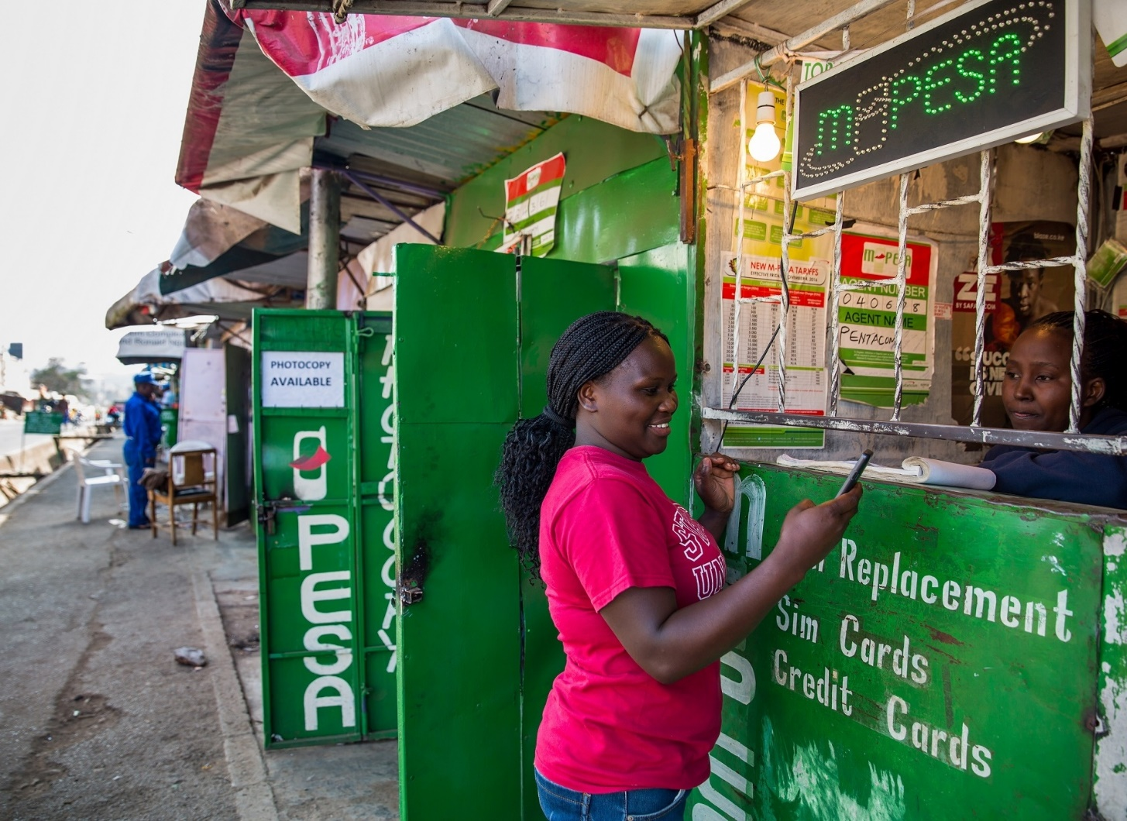
Digital Financial Services and Financial Inclusion – The Evidence
Banking the unbanked: Mobile banking has empowered women to save, invest and do business.

Slide 8
V. The Digital Financial Services: The Emerging Evidence
Finally, FinTechs can roll out sustainable business models
Business models that cut across all the sectors of the economy and push the agenda for inclusive development.
Examples: Small holder farmers and inputs, household solar energy supply, health sector payments, water vending machines in urban slums and investment in governments securities.
Digitization and public finance design: Tax policy designs, tax payments platforms and revenue administration to minimize leakages.
Platforms for e-government services that are effective and easy to reach, as well as for Government to design efficient social protection programs – has worked during the COVID-19 Pandemic.

Slide 9
VI. The Broader Picture - 4IR and the Post COVID-19 Economic Recovery Strategy
The African economies should take advantage of the digital evolution taking place around them:
They have succeeded in the financial system – Digital financial services - now need to move to the real sector.
The 4th Industrial Revolution (4IR) will be driven by technology.
The future development path will be coordinated by the digital technology in production and value addition, in markets and international trading.
The digital evolution will coordinate all the other objectives: Private investments; market developments; domestic resource mobilization; and define Africa’s development path – after the failures in the past.

Slide 10
VII. Sustaining Digital Space for Inclusive Development
Connectivity – Inclusiveness – no one should be left behind - the infrastructure for fibre optic cables is important – Scalability of the digitization process - sustainability.
Interoperability of retail electronic payments platforms, support appropriate market development and lower unit costs.
Cross-Border and Regional Payments systems and remittances payments platforms.
Electronic-ID system to cope with market innovations and secure the market.
State and Institutional capacity - Cope with market innovations and dynamism – capacity for the institutions to regulate and protect the market but also nudge the market to frontier of innovation paths.

Slide 11
From AERC
Ahsante Sana
Thank You
MERCI BEAUCOUP
www.aercafrica.org

