Slide 1

Poverty, growth, redistribution, and social inclusion in times of
COVID-19 pandemic in Africa
The AERC
Welcoming Remarks 55th Plenary Session - Biannual Research Workshop
29 November 2021
Nairobi, Kenya

Slide 2
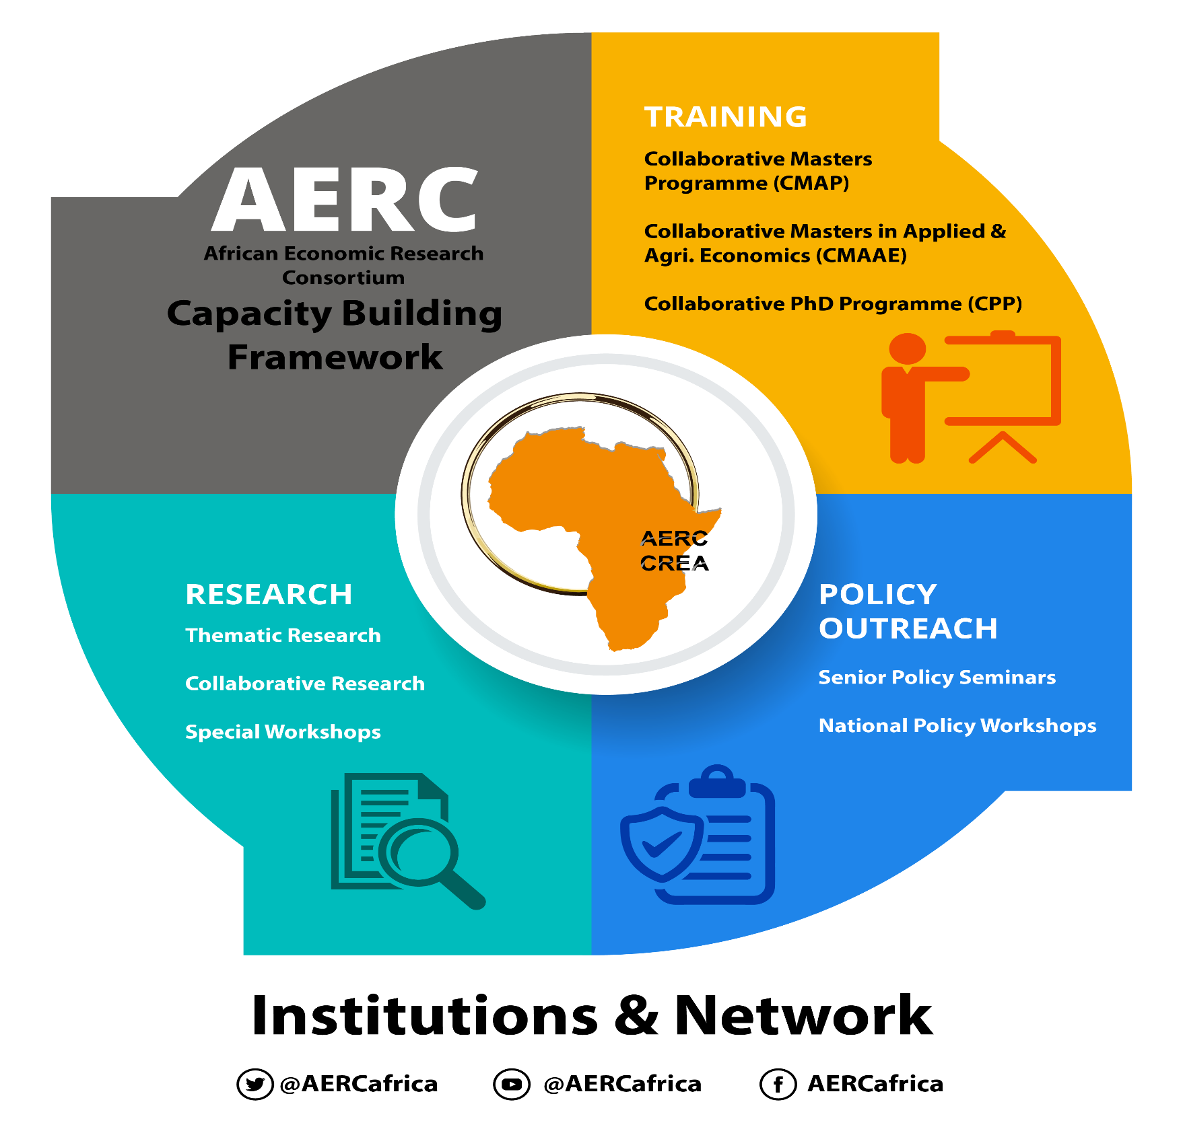
The AERC Approach to Capacity Building and Knowledge Generation in SSA

Slide 3
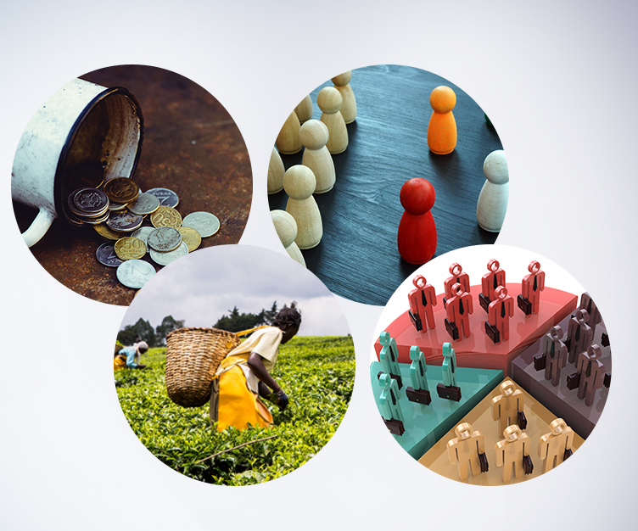
AERC Plenary Sessions
Over three decades of plenary sessions.
Examples of recent plenary themes:
  The COVID-19 pandemic and public finance in Africa: Challenges and opportunities (June 2021)
  Business Environment, Competitiveness and Economic Growth in Africa (June 2020)
  Growing with Debt in African Economies: Options, Challenge and Pitfalls (June 2019)
  Governance for Development in Africa (December 2017)
  Agriculture and Structural Transformation in Africa (November 2015)
Plenary sessions have informed, influenced, and inspired researchers and the wider public on a wide range of issues relevant to policy making.
The 55th Plenary Session
(December 2021)
  Poverty, Growth, Redistribution and Social Inclusion in Times of COVID-19 pandemic.
  Presentations from leading academics, experts and policy makers.

Slide 4
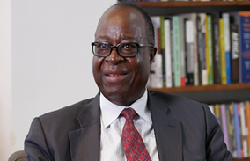
The AERC Remembers Professor Benno Ndulu
Book project in memory of Professor Benno Ndulu (led by the AERC, Shanta Devarajan, Stephen O’Connell).
The Professor Benno Ndulu Excellence Scholarship Award being developed.
Introducing Annual Memorial Lecture to honour Professor Benno Ndulu, whose objectives are:
Establishing a standing memorabilia for the legacy, work and vision of Professor Ndulu.
An opportunity to bring cutting-edge thinking on Africa’s economy, its future and prospects from internationally reputed scholars with a view of shaping AERC’s research agenda.
Ensure the Memorial Lecture informs, inspires and influences academics, policy makers, practitioners and thought leaders.
The first inaugural lecture will be delivered by Professor James Robinson on the theme of “Africa’s Latent Assets”, an inspiring research less explored in Africa’s political economy. A timely and apt tribute to Professor Benno Ndulu.

Slide 5
The 55th AERC Plenary: The Impact
Unique features:
Demonstrates AERC’s continued commitment to provide a range of policy solutions to the devastating impact of the COVID-19 pandemic through sustained engagement with policy makers, researchers and practitioners.
A distinguished Policy Panel to lead the narrative on the path to recovery from COVID-19.

Slide 6
COVID-19 pandemic, the economy and households suffering
Policy responses to combat the pandemic led to significant social and economic disruptions. Evidence suggests that at the height of the lockdown (March, May, June 2020), Africa’s GDP shrunk by 5%. During the entire period, the continent’s GDP declined by 2.5% (Ndung’u et al, 2021).
Rate of growth in economic activity proxied by night light data for the period March - August 2020.

Slide 7
Deteriorating Fiscal Balance
  Fiscal deficits have reached levels not seen since late 1990s.
Source: African Economic Outlook Supplement - Worse Case Scenario (April 2020).
2019 figures are estimates, 2020 are projections.

Slide 8
Adverse effects on households
Increase in prevalence of poverty and inequality, and poor health, negating significant gains made in the past two decades.
Millions of people without jobs, loss of jobs and food shortages (Ndung’u et al, 2021).
Pandemic has also brought out the capacity of Africans to help each other; private citizens mobilized resources to help the poor, the needy and the sick.
There is an opportunity to institute strong social protection programs in Africa to ensure support for the poorest and cushion against future negative shocks.
Country | Job loss | Income loss | Food consumption reduced | Transfer received
Burkina Faso | 20·78 | 45·12 | 46·08 | 45·92
Chad | 33·05 | 58·65 | 43·67 | 49·43
Djibouti | 34·76 | 17·18 | 43·11 | 14·94
Ethiopia | 20·00 | 50·00 | 23·00 | 13·00
Kenya | 12·00 | NA | 40·00 | 9·00
Malawi | 25·43 | 67·43 | 49·47 | 67·12
Mali | 58·54 | 51·14 | 49·25 | 38·39
Nigeria | 65·10 | 72·90 | 56·87 | 14·22
South Africa | 37·10 | 41·00 | 26·00 | 16·00*
Uganda | 54·16 | 52.87 | 25.79 | 22.5

Slide 9
The 55th Plenary discussions:
How has the COVID-19 pandemic shaped the nexus between growth, inequality, poverty, and social inclusion in Africa?
What are the policy options and challenges for redistribution and equal opportunities to break the persistence of inequality and promote social mobility?
Where is Africa when it comes to gender equality? What barriers need to be improved and enablers developed to close the gender gap in livelihoods in Africa?
Social protection program has increasingly become an important policy construct in recent years. How has it been implemented in Africa and what are the experiences?
The COVID-19 pandemic brought into sharp focus the roles of digital finance in facilitating risk-sharing and protecting millions of households from imminent hunger. How can these experiences be harnessed for anti-poverty strategy?
What structural reforms do we envisage - take advantage of the pandemic: Human capital development – Health, education and nutrition; Markets; domestic resource mobilization; digital evolution – the 4th Industrial Revolution to chat Africa’s development path?

Slide 10
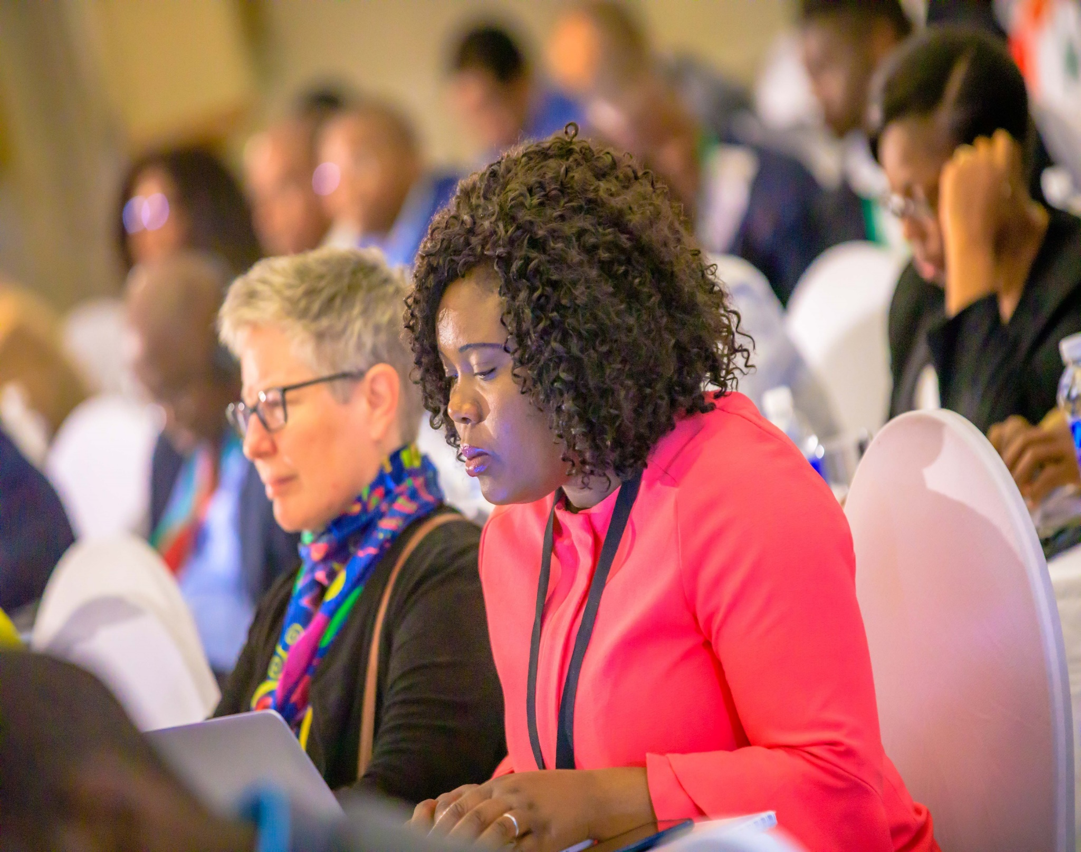
Beyond December 2021
In June 2022, panelists of researchers and lead experts to present a fully developed paper on:
  Evidence on Poverty, growth, redistribution, and social inclusion in times of COVID-19 pandemic in Africa.
  Policy directions from the December 2021 Plenary.
Findings to be published in a special issue of the Journal of African Economies, accompanied by policy briefs and blogs.

Slide 11
From The AERC
AHSANTENI SANA
MERCI BEAUCOUP
Thank You
www.aercafrica.org

