Slide 1

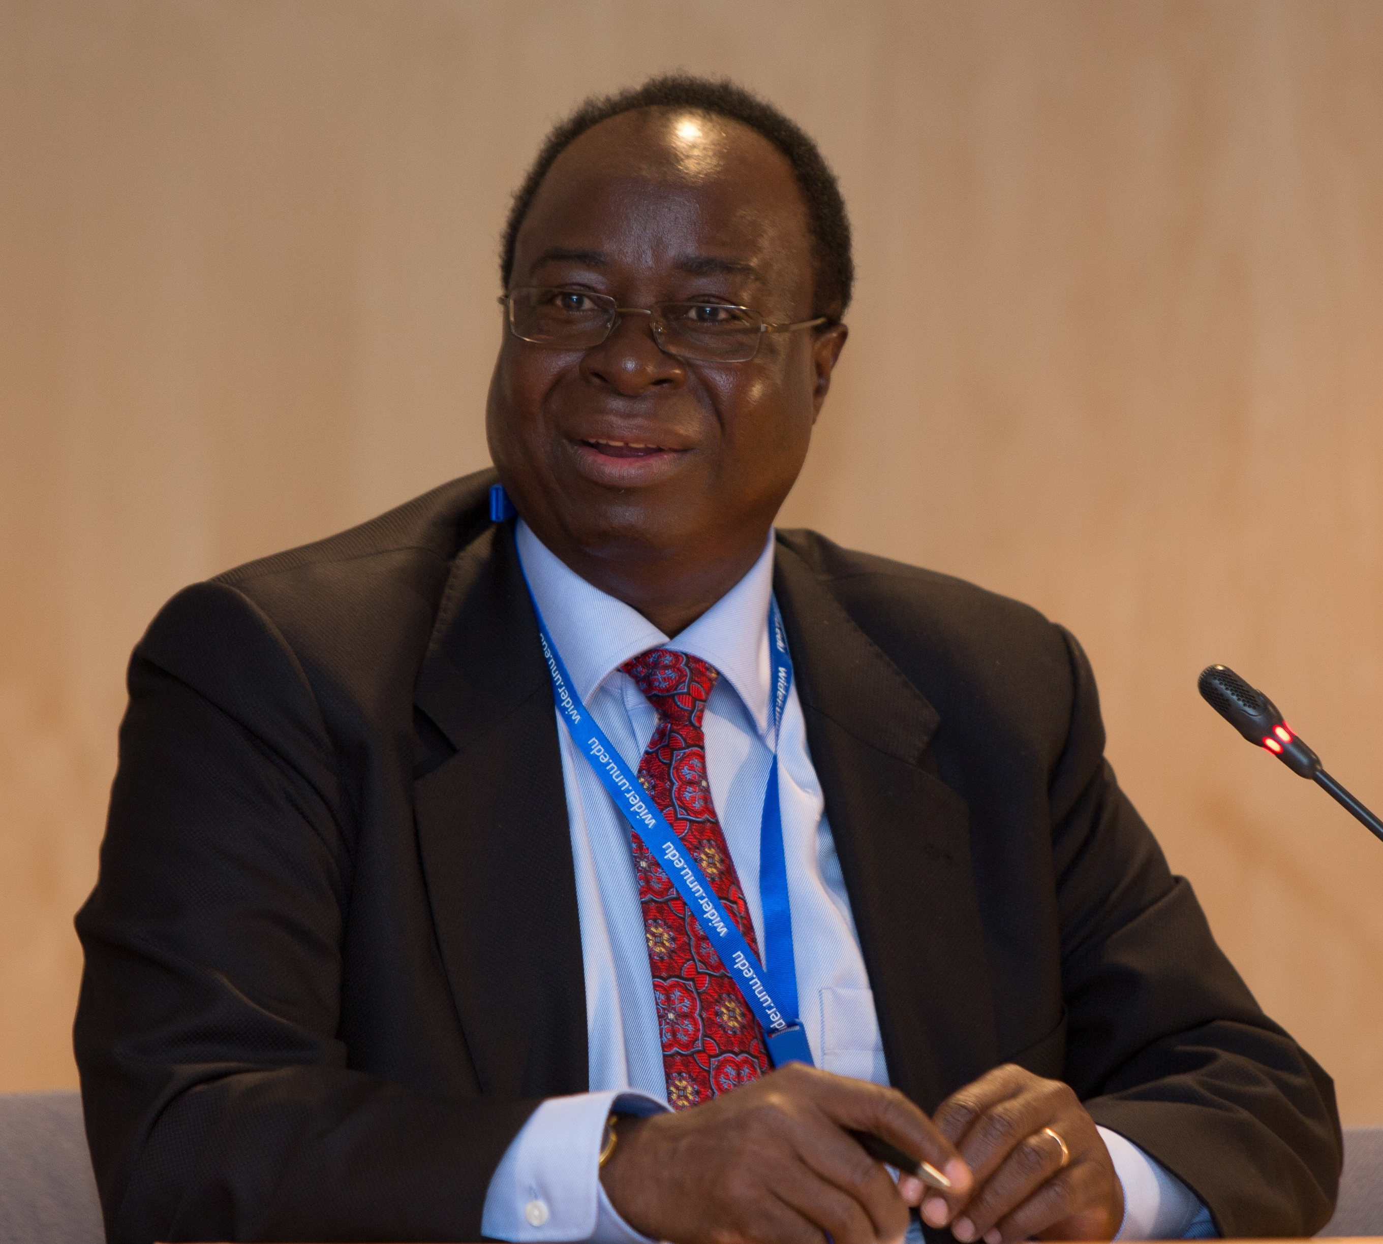
The Way Forward: Keeping Memories of Benno Ndulu Alive
Memorial Lectures during the December 2021
Bi-Annual Conference.
“I do believe that the increase in political pluralism, in combination with greater unity among African aid donors, bodes well for a continuation of Africa’s growth recovery.”
Prof. Benno Ndulu
Publication of a Volume in Benno’s memory.
Establish a Scholarship in his name – The Benno Ndulu Scholarship Award – for the best male and female candidates every year in the AERC Training programmes.

Slide 2
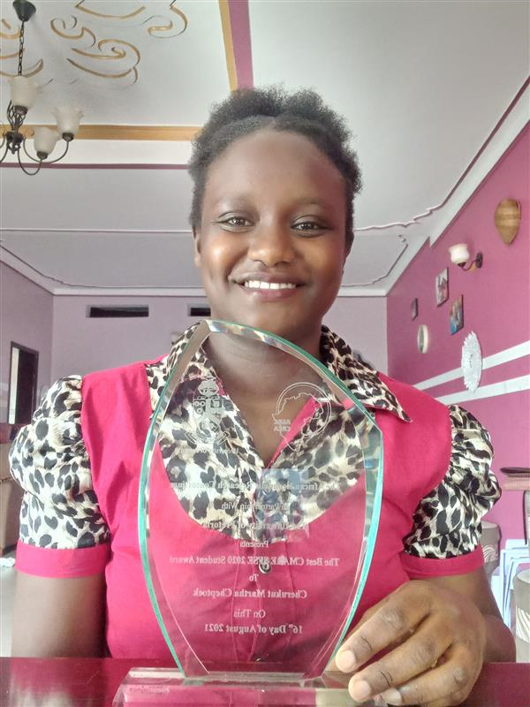

Slide 3
